Slide 1

VCONNECT -connecting people
PROJECT MENTOR
ANJALI AGRAWAL
PROJECT MADE BY
PRIYANKA SHARMA-15UCS170
SONAL JAIN-15UCS054

Slide 2
VCONNECT PURPOSE
A place to share knowledge and better understand the world.
Vconnect is a site where different people can discuss their queries with respect to different categories and topics they want and even reply to the queries of other people.
Any user can create Question category, Question topics in that category and any user can give reply to any of the topics if they have an account on vconnect.

Slide 3
MAJOR TECHNOLOGIES USED
HTML
CSS
PHP
MYSQL
APACHE

Slide 4
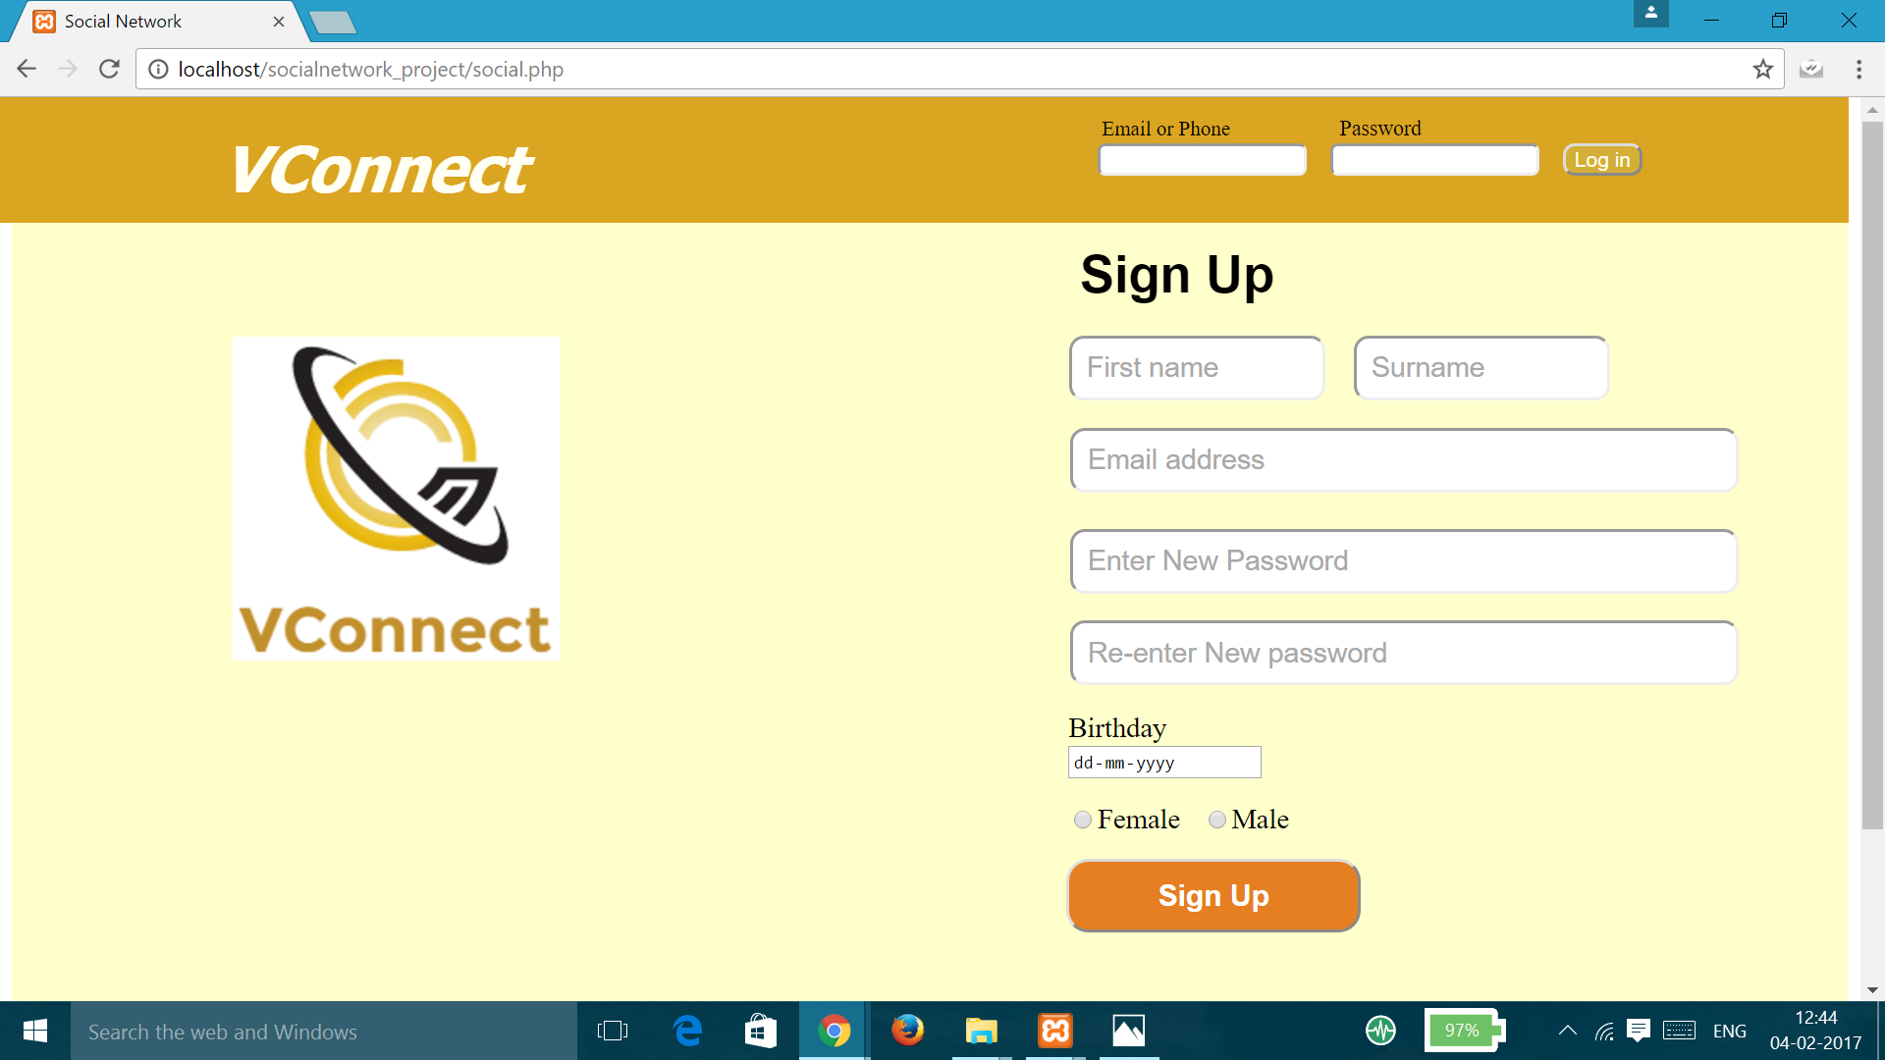
USER LOG IN AND SIGN UP PAGE

Slide 5
WEBSITE CONTAIN SIX PAGES
1.HOME PAGE
2. CREATE CATEGORY PAGE
3.CATEGORY PAGE
4. CREATE TOPIC PAGE
5. TOPIC PAGE
6.CHANGE PASSWORD PAGE

Slide 6
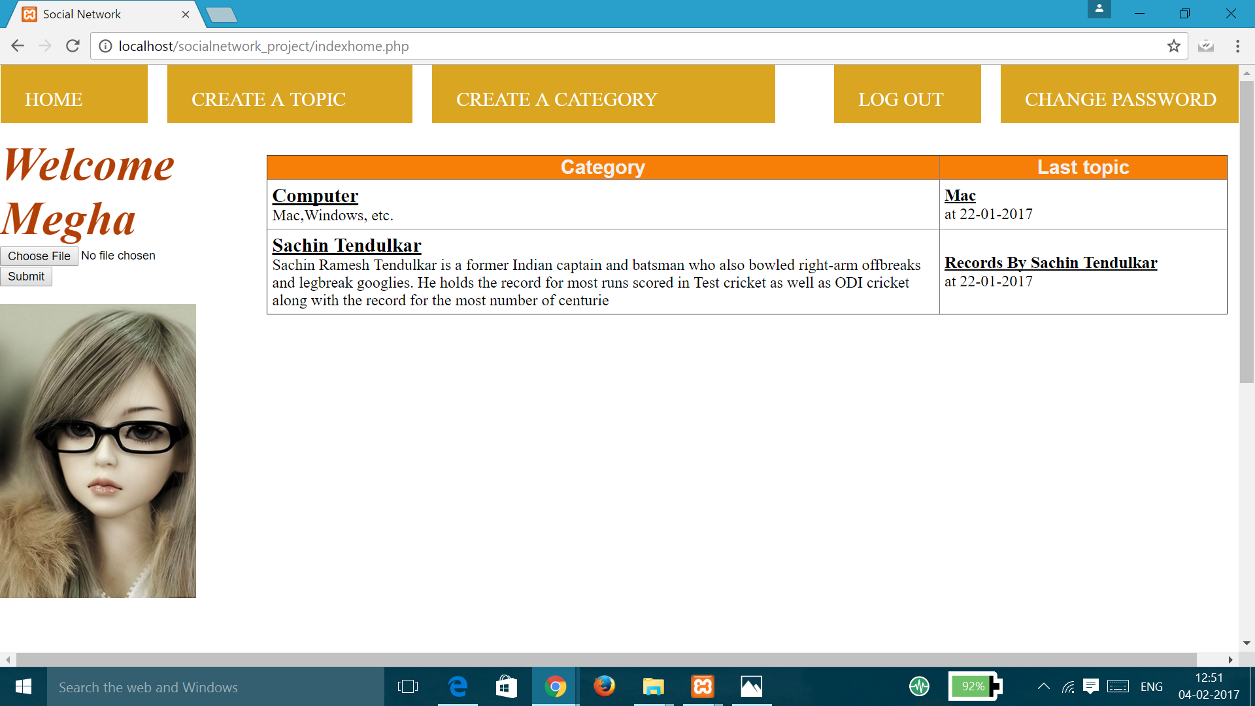
HOME PAGE

Slide 7
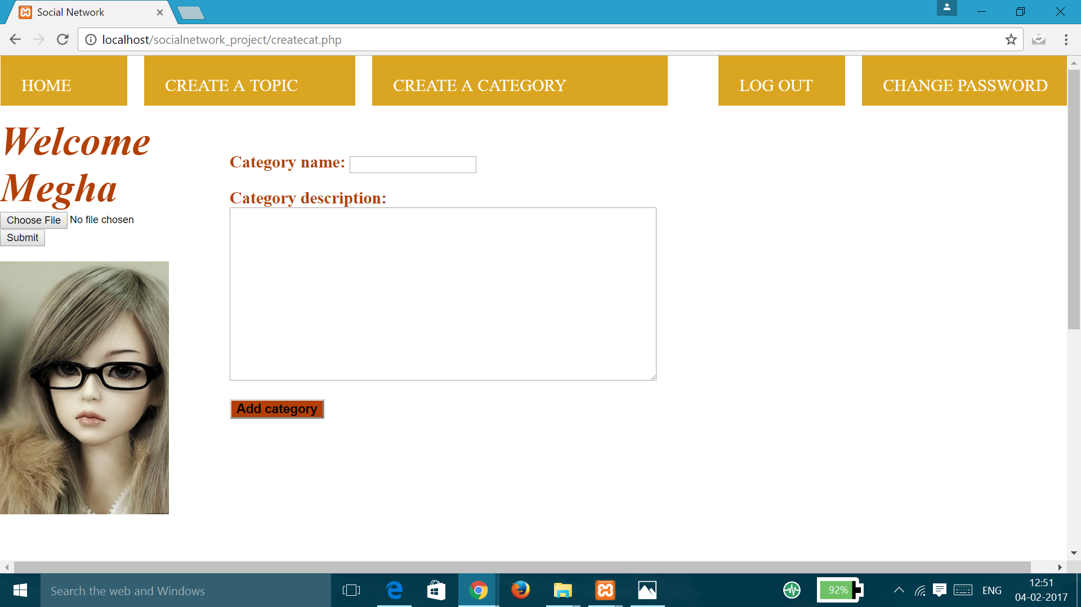
CREATE CATEGORY PAGE

Slide 8
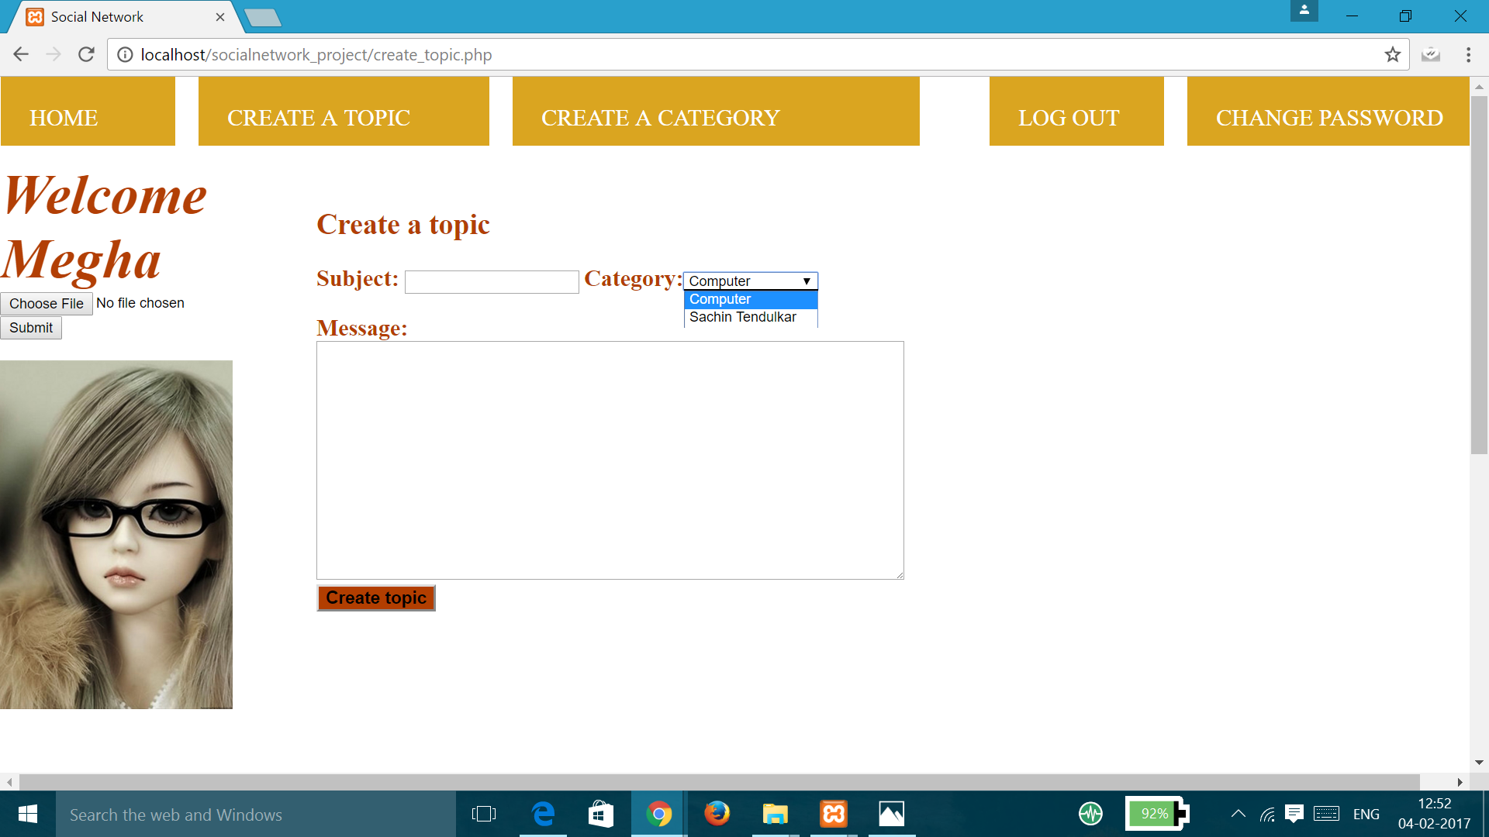
CREATE TOPIC PAGE

Slide 9
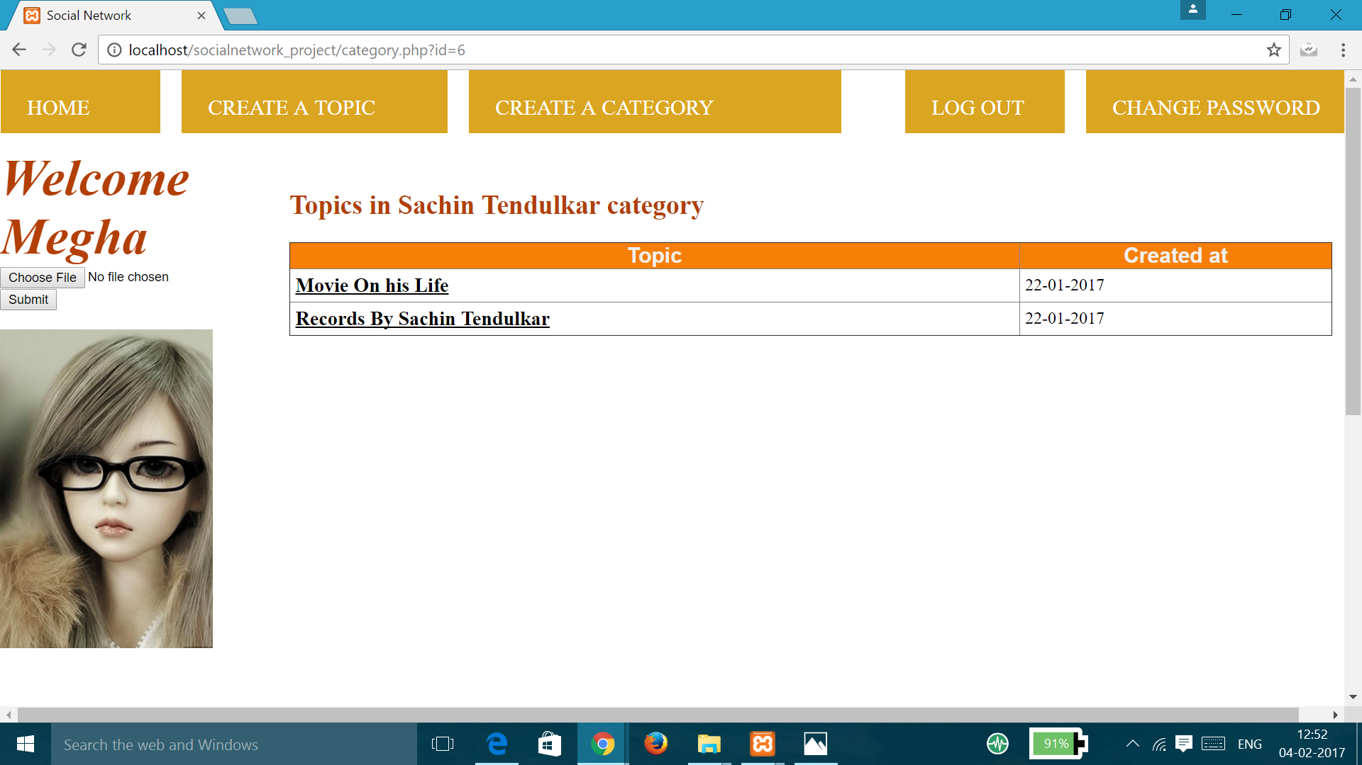
CATEGORY PAGE -When you click on a category

Slide 10
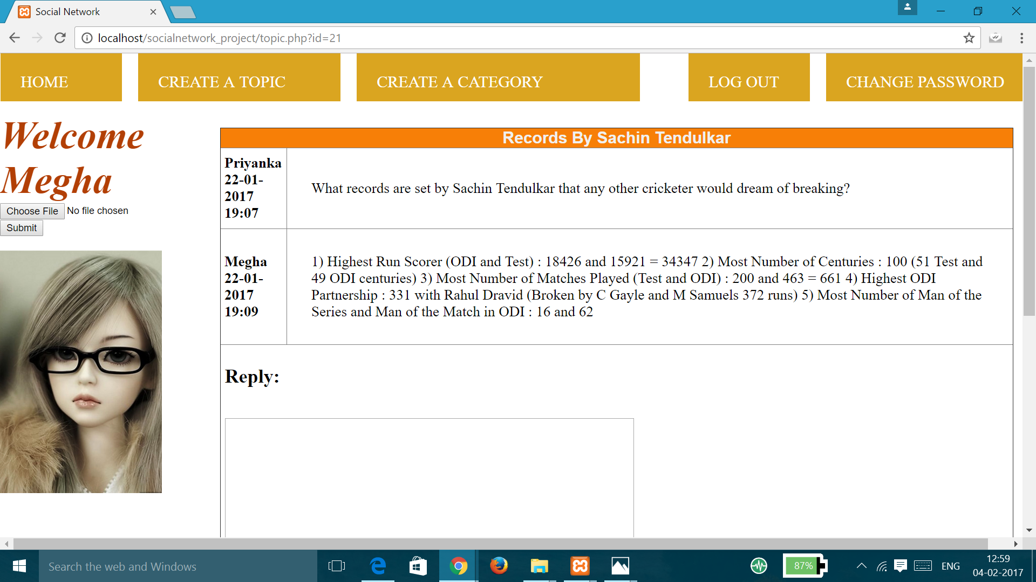
TOPIC PAGE - When you click on a topic
Can give Replies on this topic

Slide 11
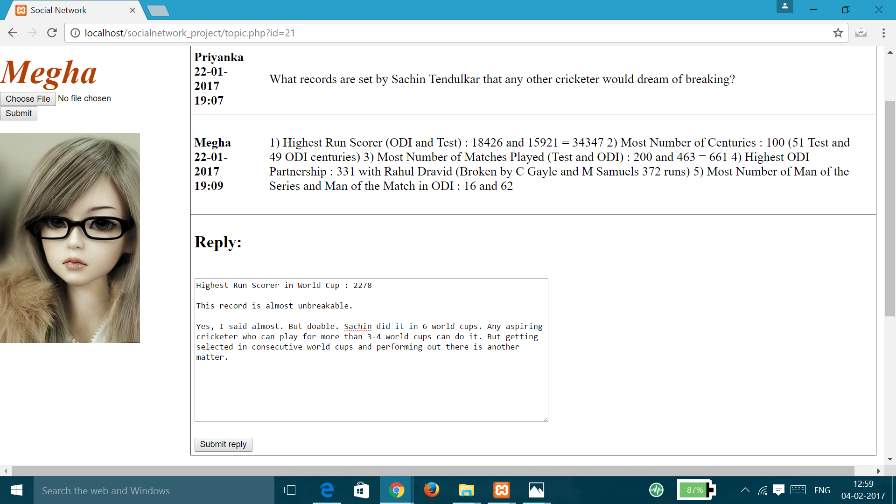
REPLY ON A QUESTION

Slide 12
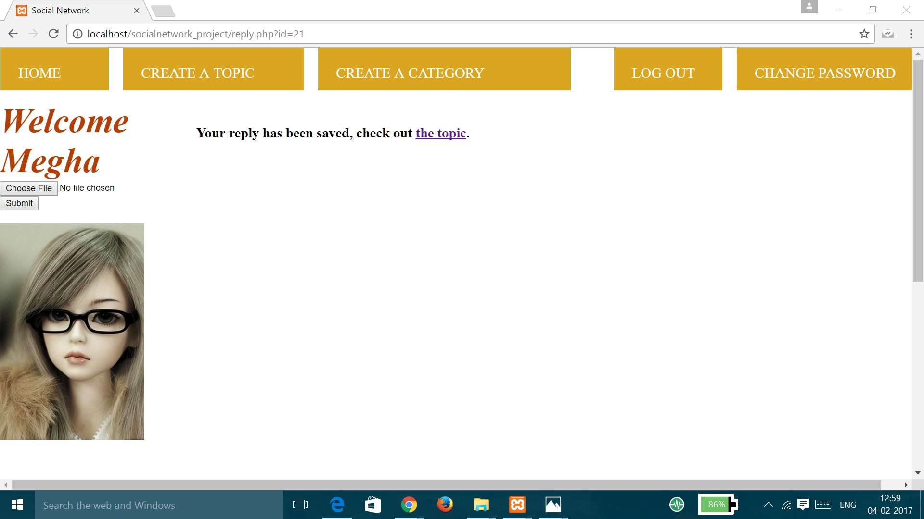
WHEN YOU WILL SUBMIT REPLY

Slide 13
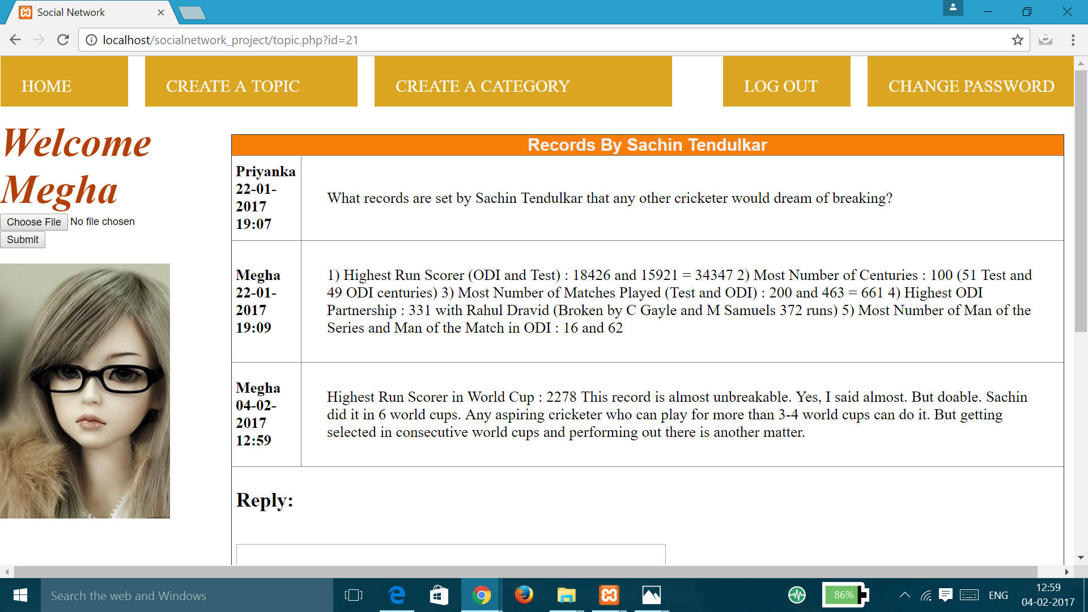
REPLY DISPLAYED IN TOPICS

Slide 14
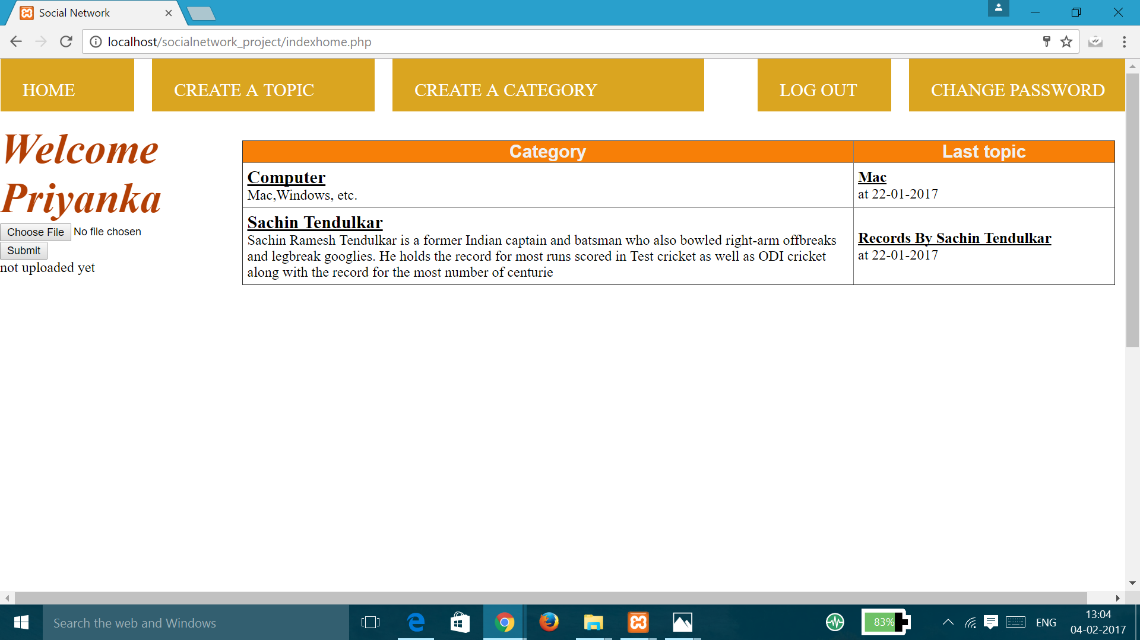
BEFORE UPLOADING THE PROFILE PHOTO

Slide 15

WHEN YOU SUBMIT PHOTO

Slide 16
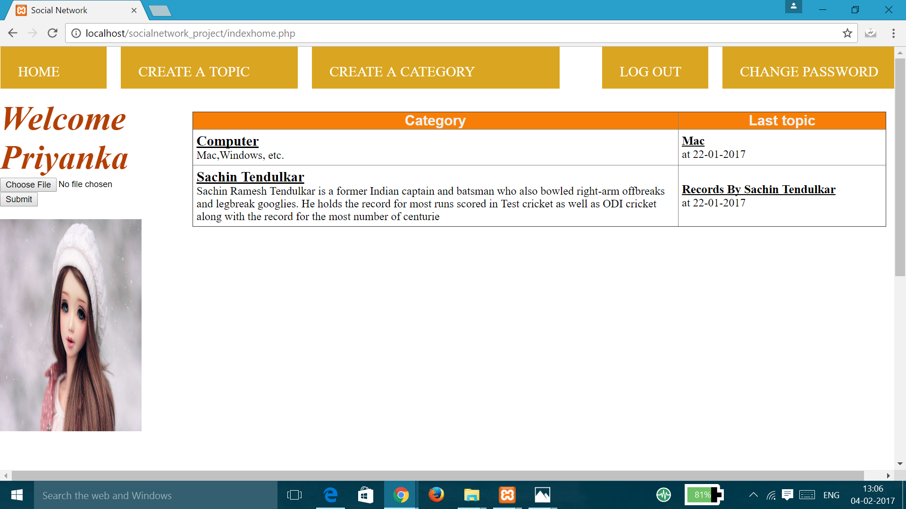
PROFILE PHOTO UPDATED

Slide 17
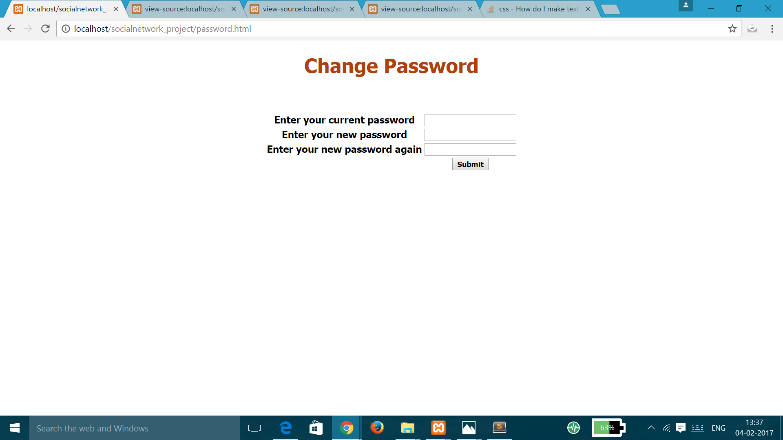
CHANGE PASSWORD

Slide 18

THANK YOU

